Slide 1


ONLINE WORKPLACE ETIQUETTE
Paulina, Odie, Vanessa, Sonia, Kyriaki, Alfina
1

Slide 2

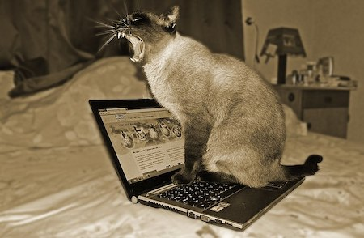
What is online workplace etiquette?
Why is Netiquette Important?
Professional Image: Online communication is often the first impression you make in professional settings. Your ability to communicate clearly and respectfully can shape how others view you.
Avoid Misunderstandings: Without non-verbal cues (like body language and tone), online communication can easily be misunderstood. Netiquette helps to prevent confusion and conflict.
Builds Trust: Respecting others' time, privacy, and opinions fosters a positive and professional online environment.
Refers to the guidelines for respectful and effective communication online
Communication online can be through email, social media, or virtual meetings.
Fig 1,. A cat violates digital etiquette by sitting on a keyboard and yawning.
2

Slide 3

Who is the training for?
The training is beneficial for people who are communicating professionally through digital platforms in a work setting.
For example:
1) New hires or Interns
2) Telecommuter
3) Job seekers
4) Managers and Clients
5) Freelancers
3

Slide 4

Level of preformance desired
Composition
Crafting clear, concise, and well-structured emails.
Utilizing appropriate salutations, tone, and language.
Appropriateness
Recipient Management
Properly using CC and BCC features.
Recognizing the importance of timely responses and follow-ups.
Timeliness
Error Mitigation
Avoiding common email mistakes such as typos, informal language, and improper formatting.
4

Slide 5


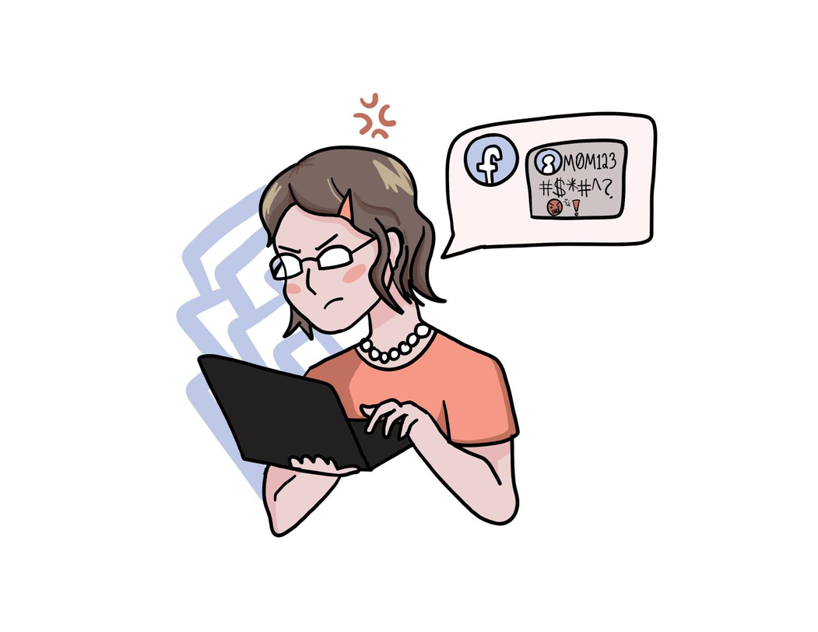
What is inappropriate Netiquette?
The use of poor manners or language when communicating online
Examples:
Not responding on time
Using coarse language
Ignoring people
Sending inappropriate links or photos
Spamming
Sending inappropriate links or photos
5

Slide 6


Cultural differences
Root cause of
learning gap
In South-East Asian cultures, making eye contact with individuals of the opposite sex, authority figures, or elders may be viewed as disrespectful or unsuitable.
Generational Differences
Gen Z and Boomers have very different “slang” and this can lead to confusion
Gender Norms
Women tend to use overly apologetic language while men use more direct language
6

Slide 7
Assessment Methods
Inputs/sources
Surveys
Focus Groups
Document Review
Self-Assessments
Performance Metrics
Training Materials
Standardized Messaging Templates
Online Learning Platforms
Role Playing Scenarios
Assessment tools
Communicate Company Email Policy
Time Allocation for Training

Slide 8
Improved Professional Communication
Boosted Productivity
Unified Messaging
Faster Response Times
Increased Confidence
Stronger Workplace Relationships
Fewer Errors
Compliance with Company Policies
Positive Feedback System
Outputs/goals
8

Slide 9
Conclusion
Best practices for online communication
Ensure clarity, professionalism, and consideration in every digital exchange.
Foster a positive, constructive, and respectful atmosphere in the virtual workplace.
9
Notes:
Definition: Guidelines for respectful and effective online communication. >This is about using clear communication when working online. This includes sending respectful emails, speaking professionally in virtual meetings, and being considerate of others' time. Following these rules helps to foster a friendly, productive work environment. Good online etiquette builds trust and helps people work better together, even when they're not in the same place.
Key Points: Be clear, professional, and considerate in all digital interactions. > it's important to be clear so that your message is easily understood. Always remain professional, even in casual conversations, to maintain a respectful tone. Your messages help convey thoughtfulness and encourage teamwork. Following these key points ensures smooth communication and avoids unnecessary misunderstandings.
Why It Matters: Maintains a positive, productive, and respectful virtual work environment. >Maintaining good online etiquette is crucial to creating a positive and respectful virtual work environment. It helps people feel valued and encourages clear communication, which leads to better collaboration and fewer misunderstandings. When everyone follows these guidelines, it fosters a sense of professionalism and trust among colleagues. A respectful online space also helps increase productivity by reducing distractions and promoting focus. Ultimately, good etiquette ensures that everyone works together smoothly, even when working remotely.

Slide 10
THANK YOU
10

